Slide 1
Smartphone Poster
Photoshop
Unit 6 – Digital Graphics

Slide 2
Aim – To create a smartphone poster using Photoshop
Objectives
All learners to complete the Quizziz to check prior learning of Photoshop.
All students to use the Magic Wand & the quick selection tool effectively to remove a background.
Most students to identify the correct descriptions for the toolbar tools and edit the images provided using the correct tools.
Some learners to create a Smartphone poster from a set of individual assets using a range of Photoshop tools.

Slide 3
Quizziz
Topic - Photoshop tools
Joinmyquiz.com

Slide 4
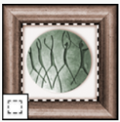
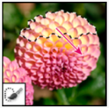


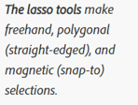






Slide 5
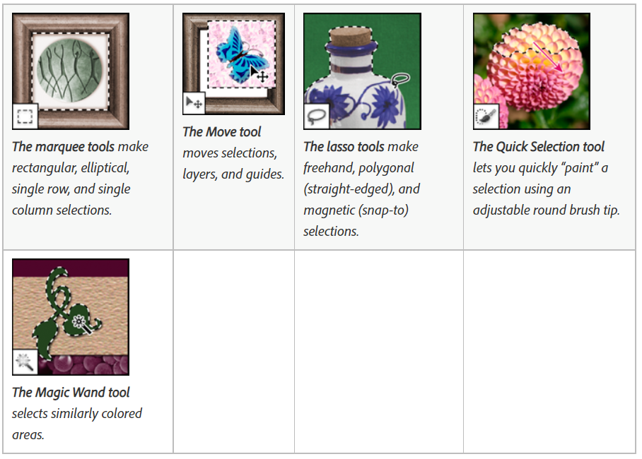

Slide 6
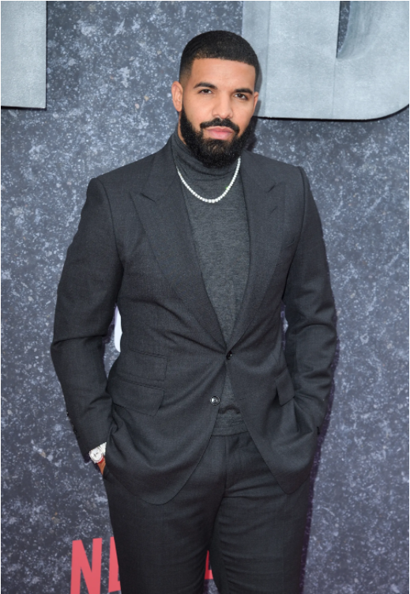
Activity
Use the quick selection tool to edit the image of drake.
Also use:-
The magic Wand tool
The move tool
Lasso tool

Slide 7

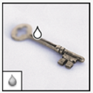
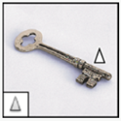
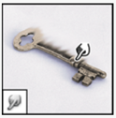

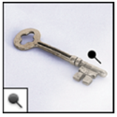

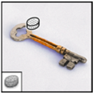







Slide 8
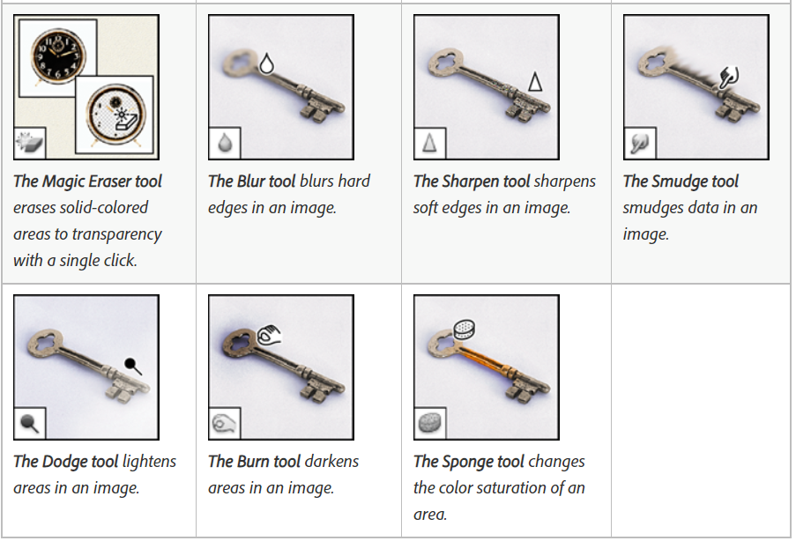

Slide 9
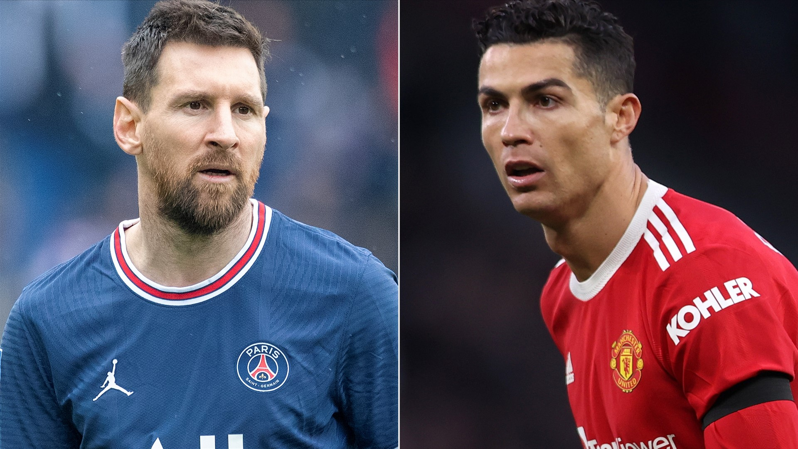
Activity
Edit the picture of 2 famous footballers by using the following tools:
Magic Eraser, blur tool, dodge tool, sponge tool and the sharpen tool.

Slide 10
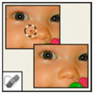
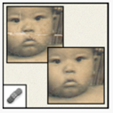
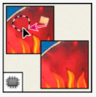
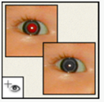

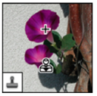
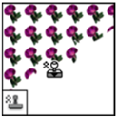

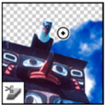








Slide 11
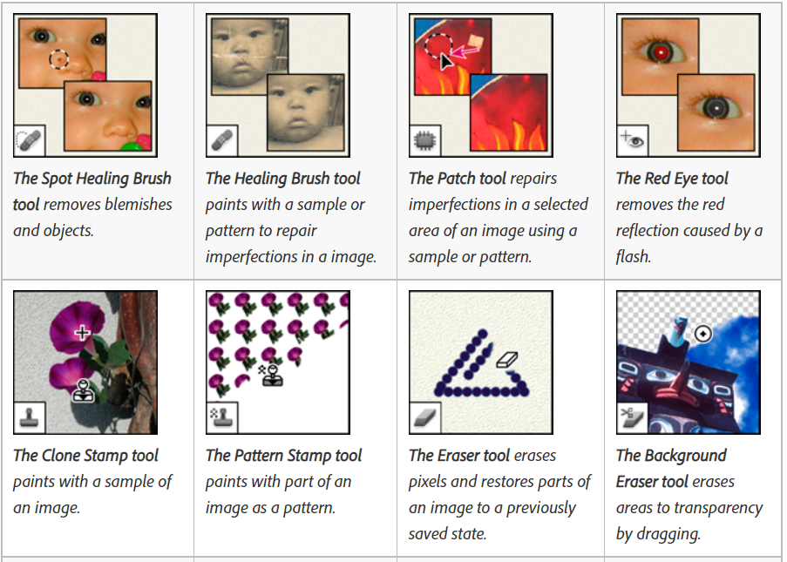

Slide 12
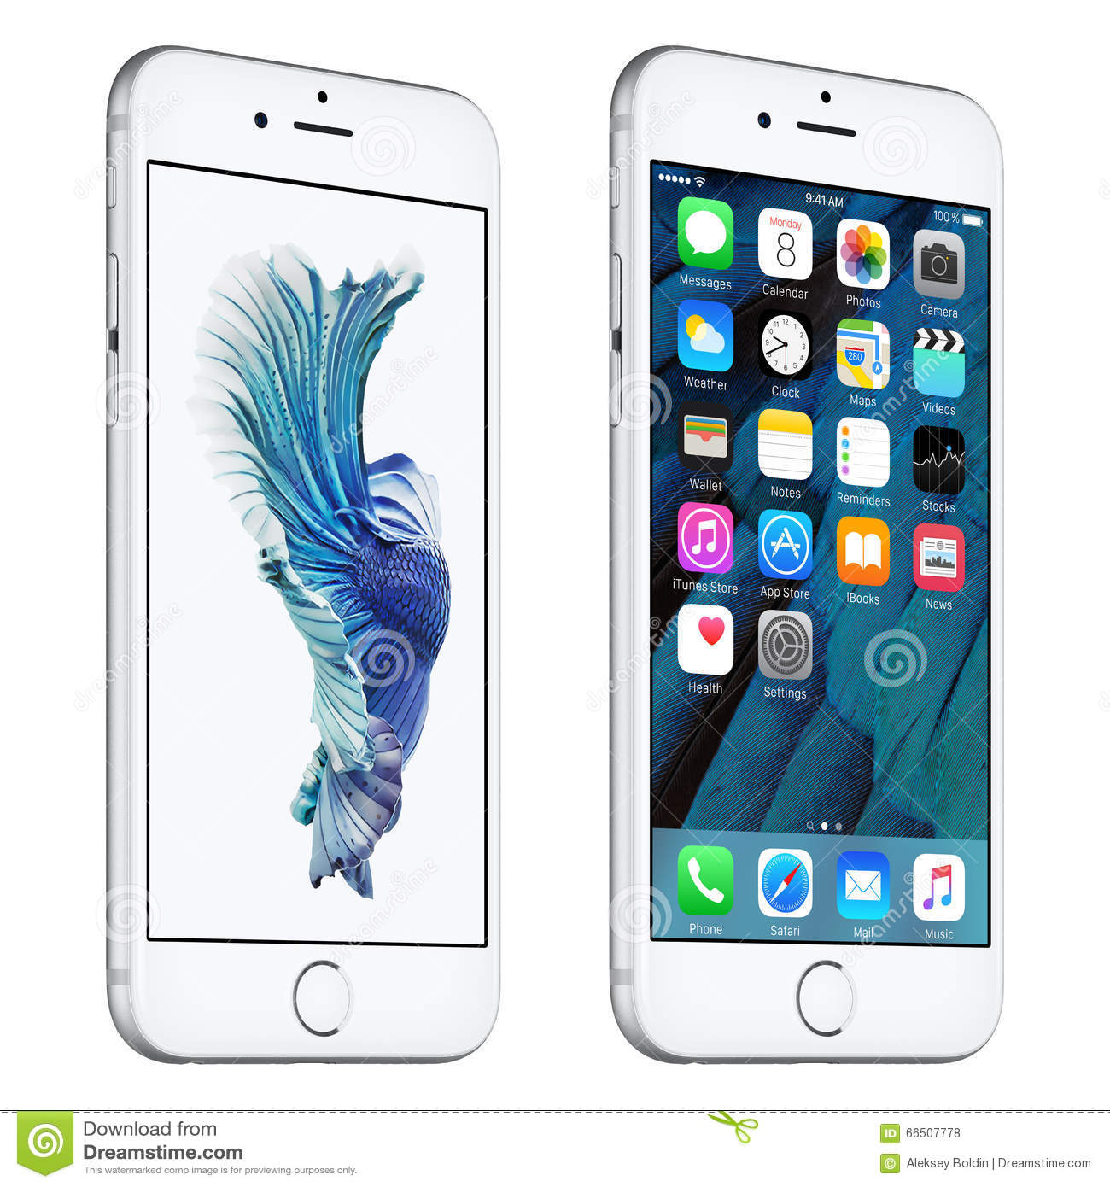
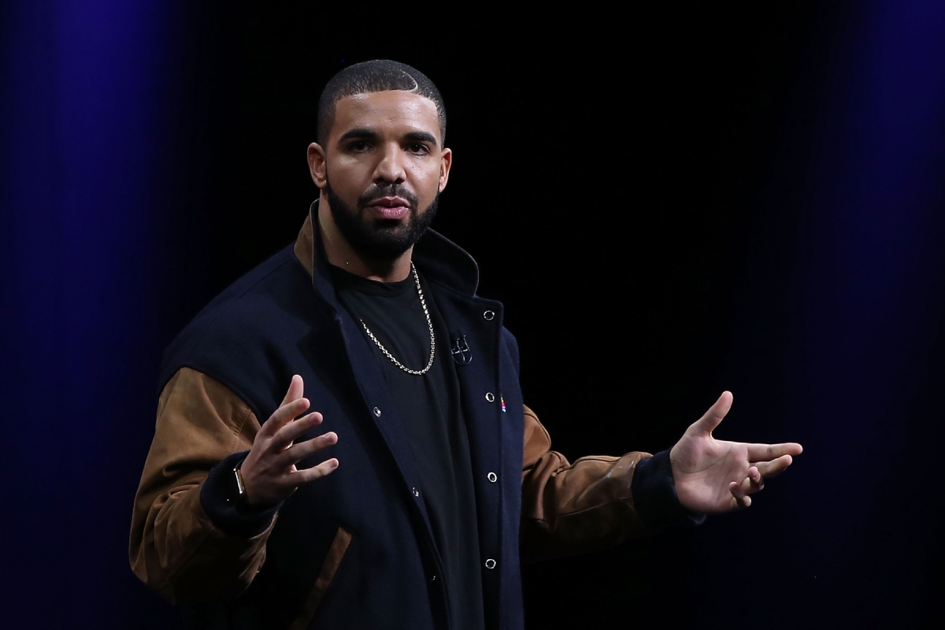

Activity
Create a poster using the objects from the previous slide (Drake etc).
You may use additional items.

Slide 13
Aim – To create a smartphone poster using Photoshop
Objectives
All learners to complete the Quizziz to check prior learning of Photoshop.
All students to use the Magic Wand & the quick selection tool effectively to remove a background.
Most students to identify the correct descriptions for the toolbar tools and edit the images provided using the correct tools.
Some learners to create a Smartphone poster from a set of individual assets using a range of Photoshop tools.

Slide 14
Activity
Evaluate your poster by writing about all of the tools you have used from Photoshop. Also discuss the good points about your poster and how can you improve your poster.

